Slide 1
RFID UNIVERSAL KEY
A single key solution using RFID via ESP32
Project by:
P.N.L.N.SARMA

Slide 2
CONTENTS:
Introduction
Objective
Components
Block Diagram
Working Principle
Stage 1
Stage 2
Stage 3
Applications
Advancements

Slide 3
INTRODUCTION
RFID UNIVERSAL KEY relies on the concept of simplyfing the daily use of different types of KEYS and IDcards by replacing it with RFID cards. In this process we can reduce the usage of different KEYS such as House keys, vehicle keys, office keys etc.
Similarly we can replace our all conventional IDs such as Aadhar card, Driving Licence, Office/College IDs etc with RFID in turn to solves the problem of storage and increases the convinence of accessibility.

Slide 4
OBJECTIVE
Aim of this project is to come up with a prototype of a RFID system interfaced via ESP32 to make 3 Basic stages of the project.
Stage1:RFID Access System
Stage2:RFID Personalized switch
Stage3: RFID Universal Identification

Slide 5
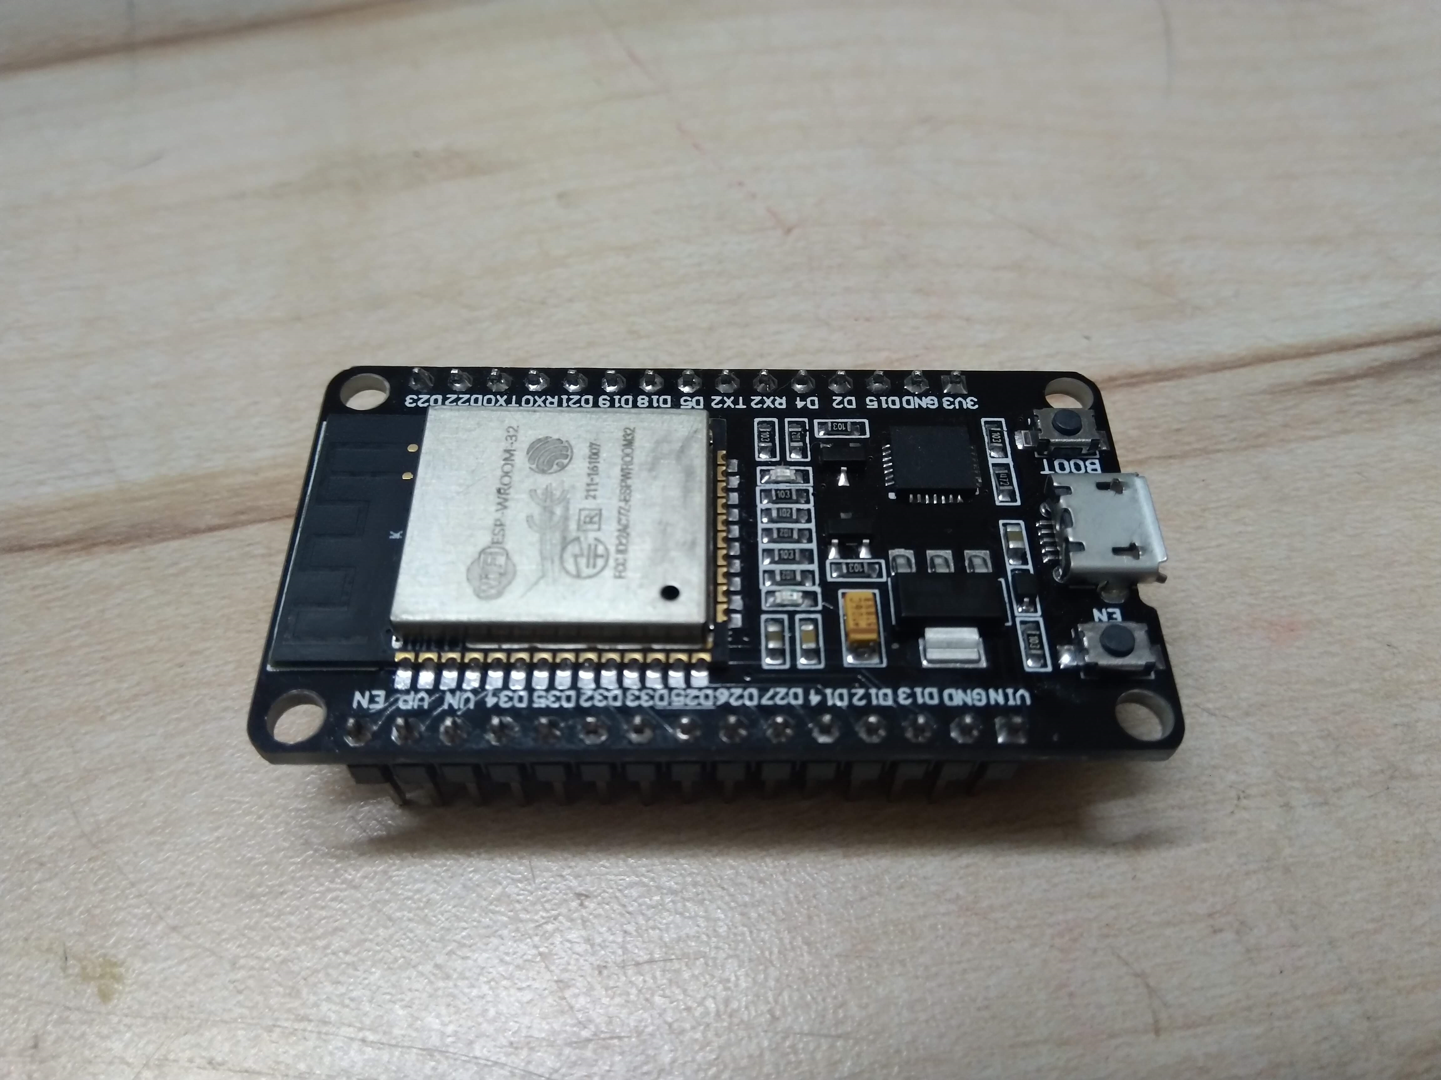
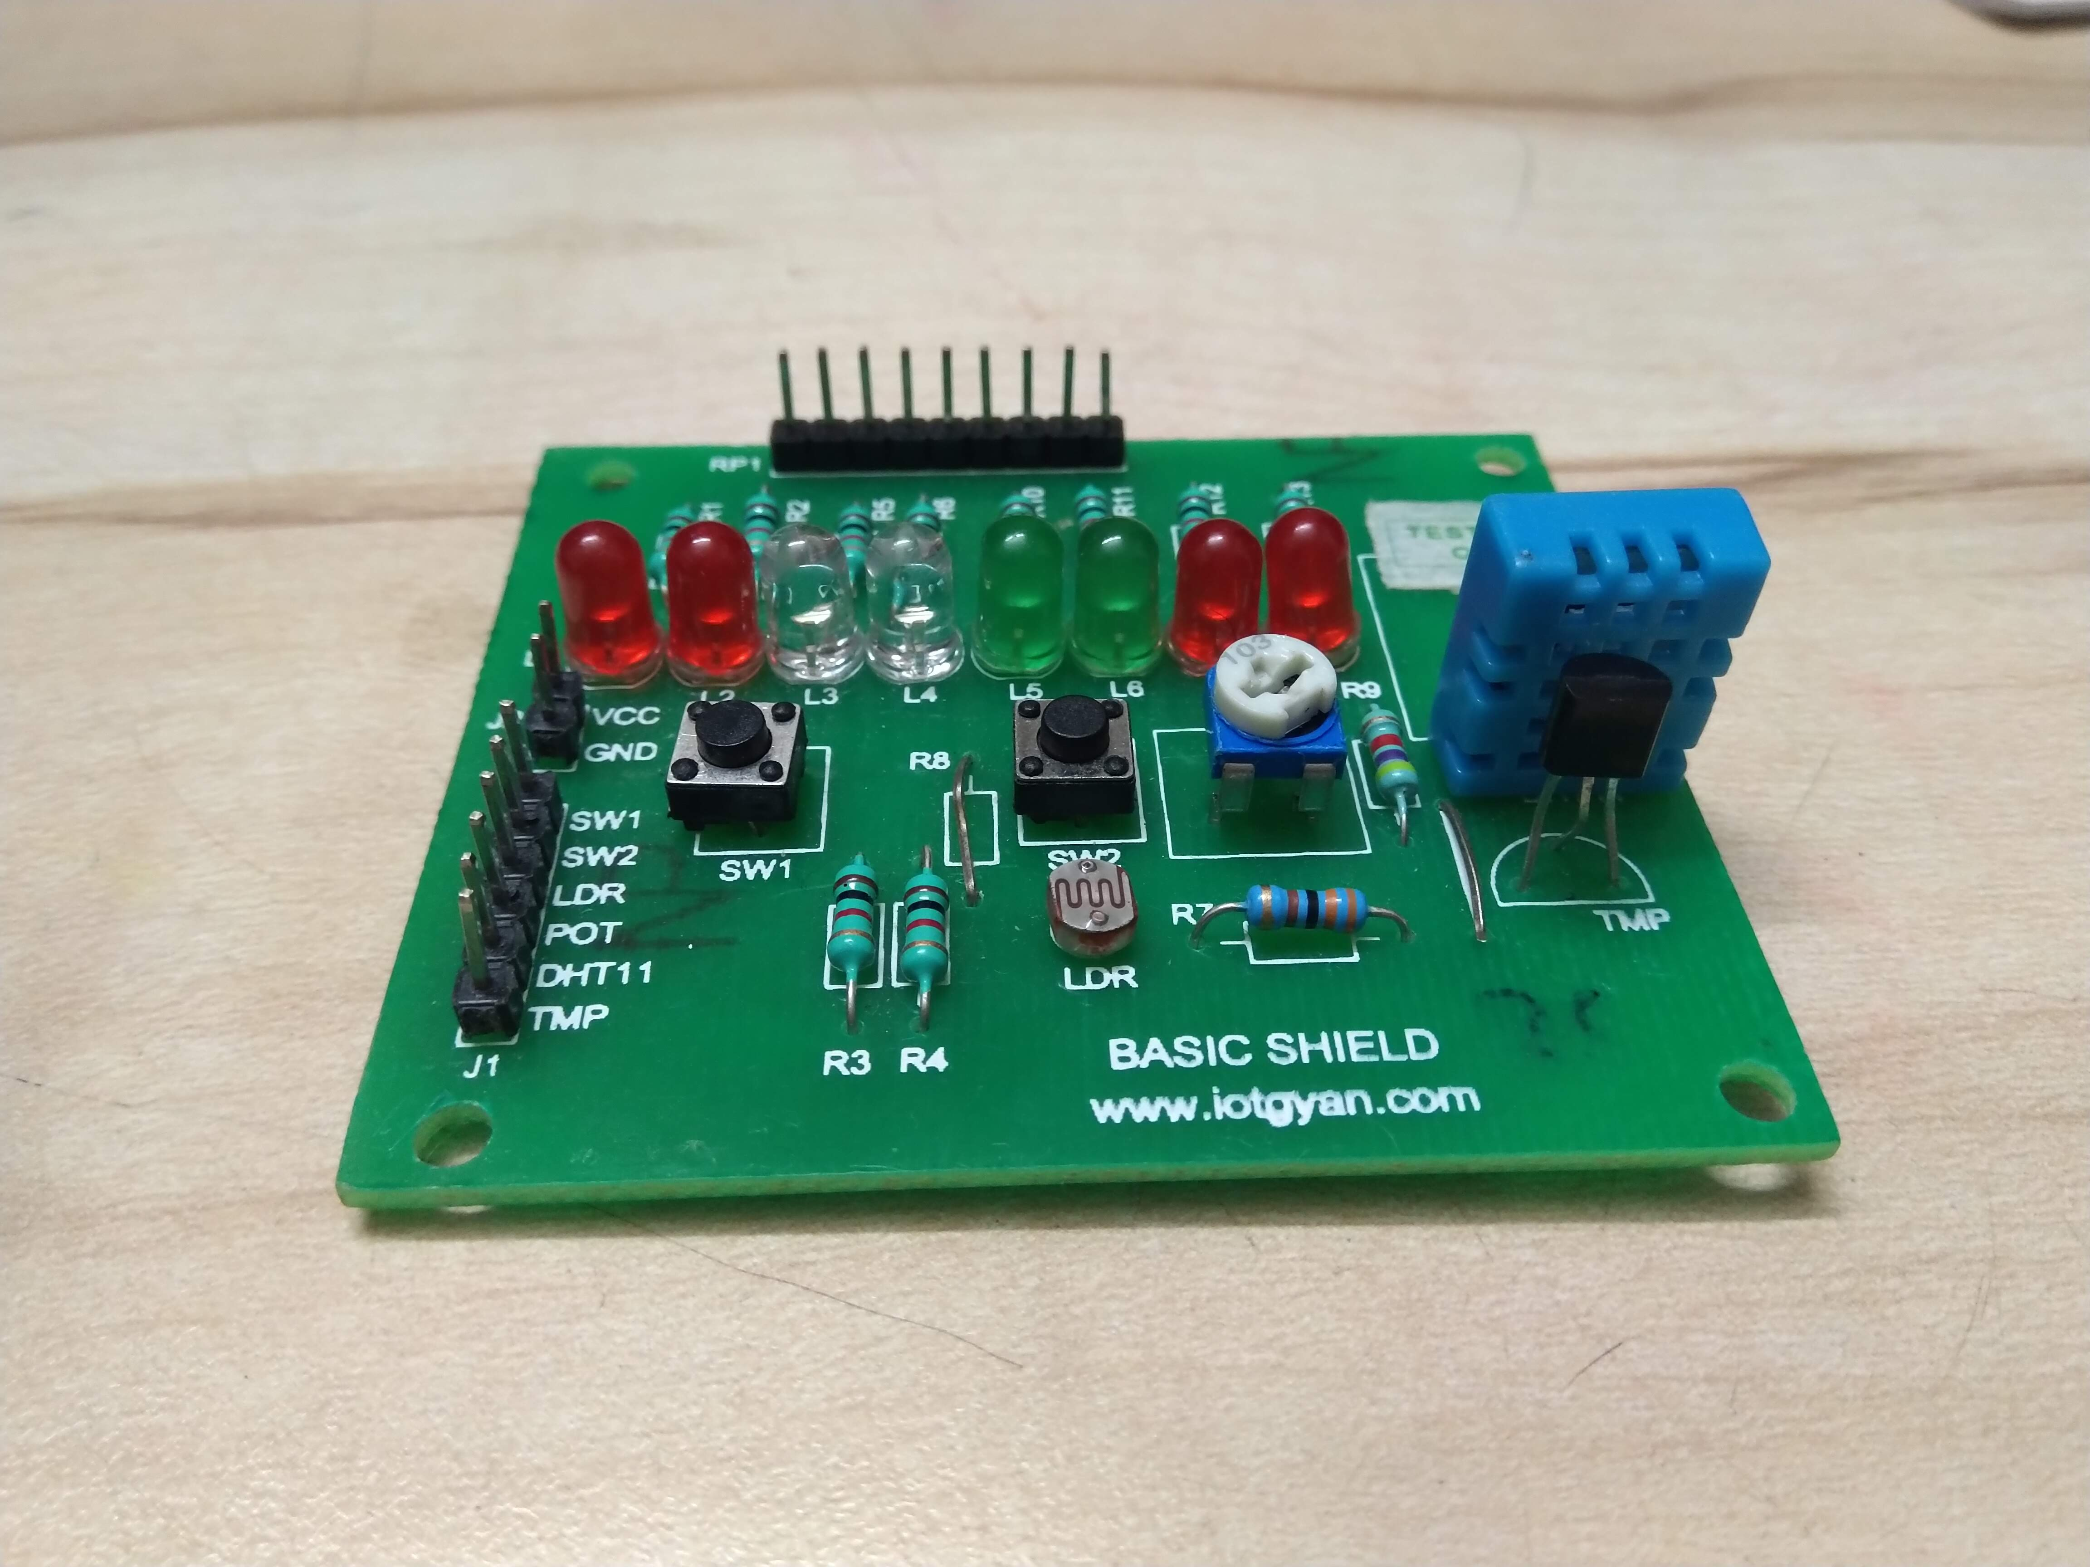
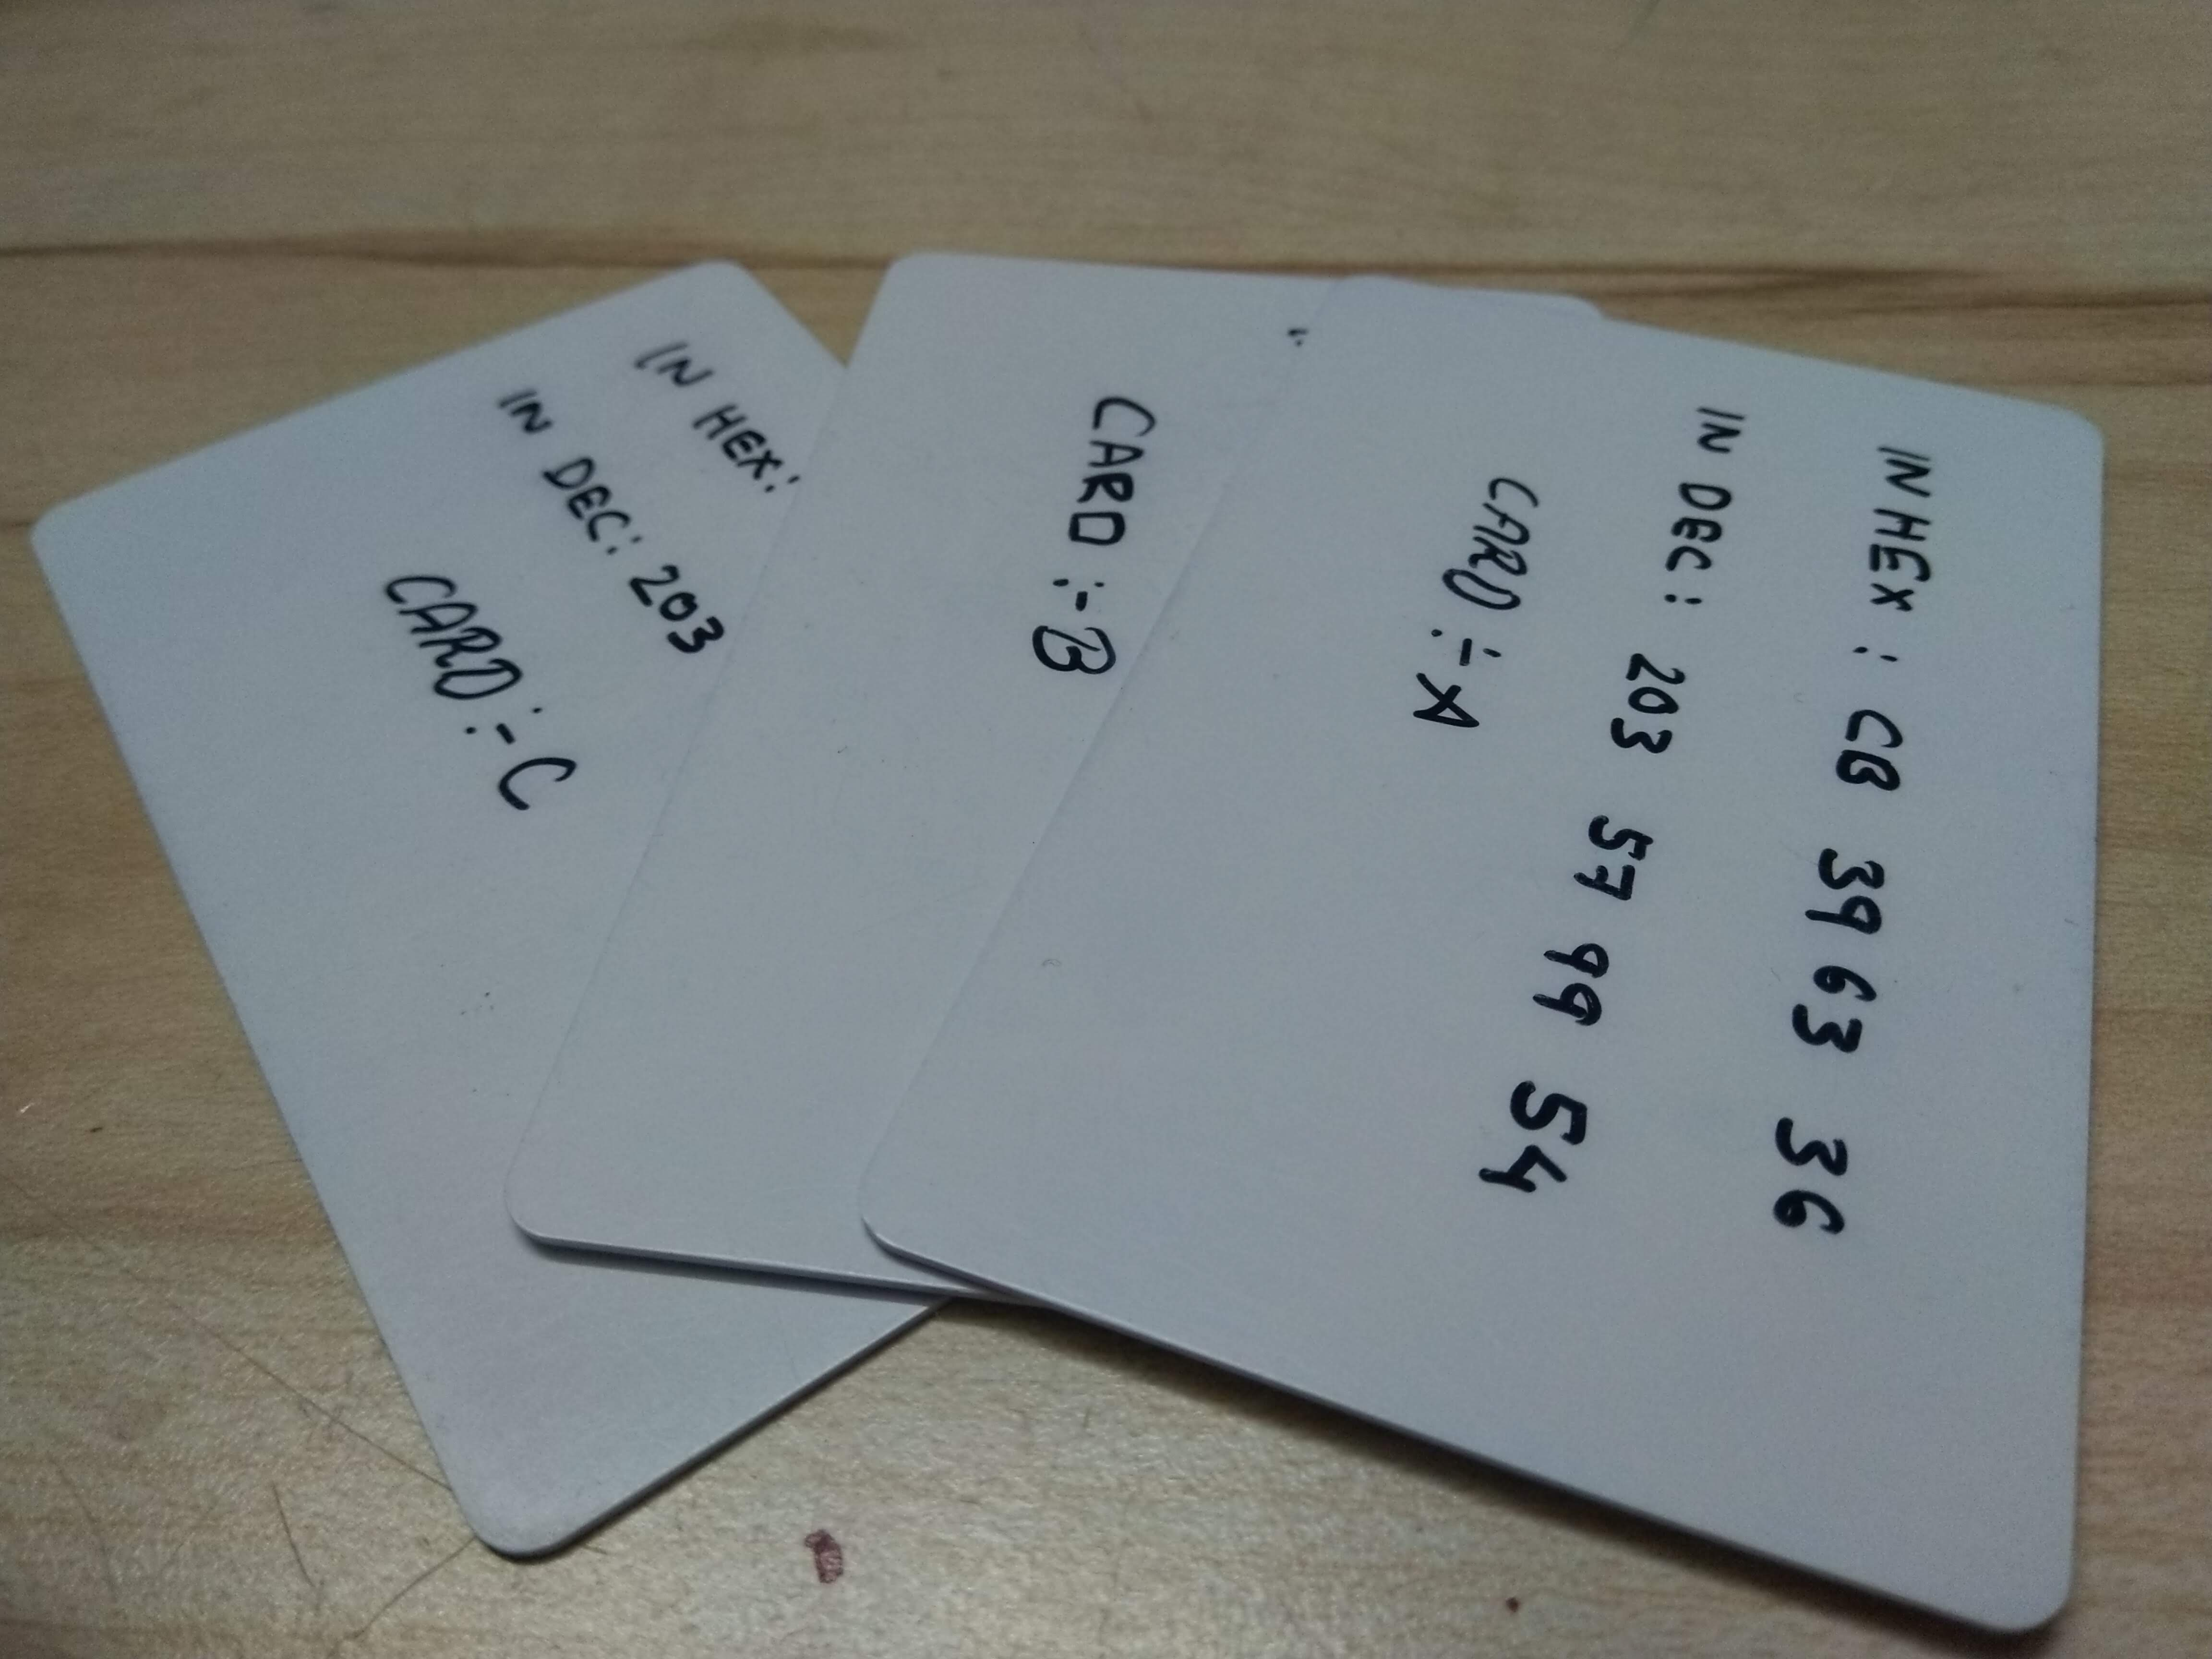
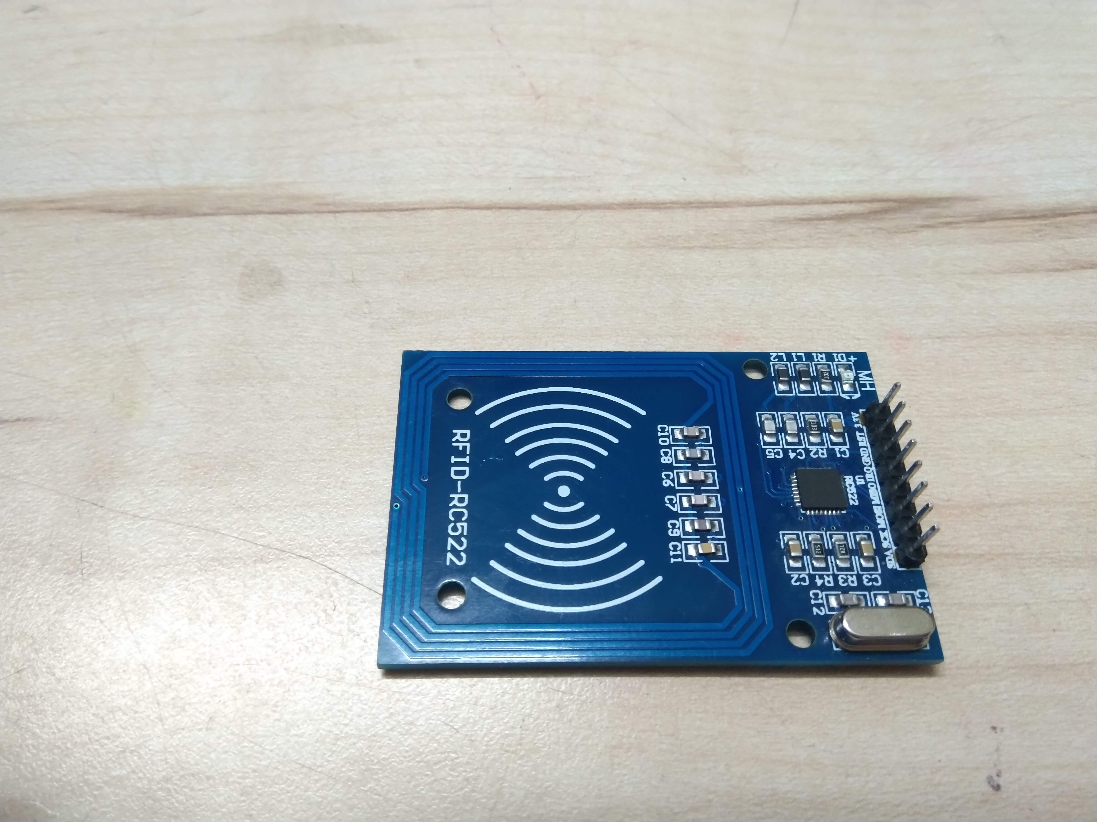
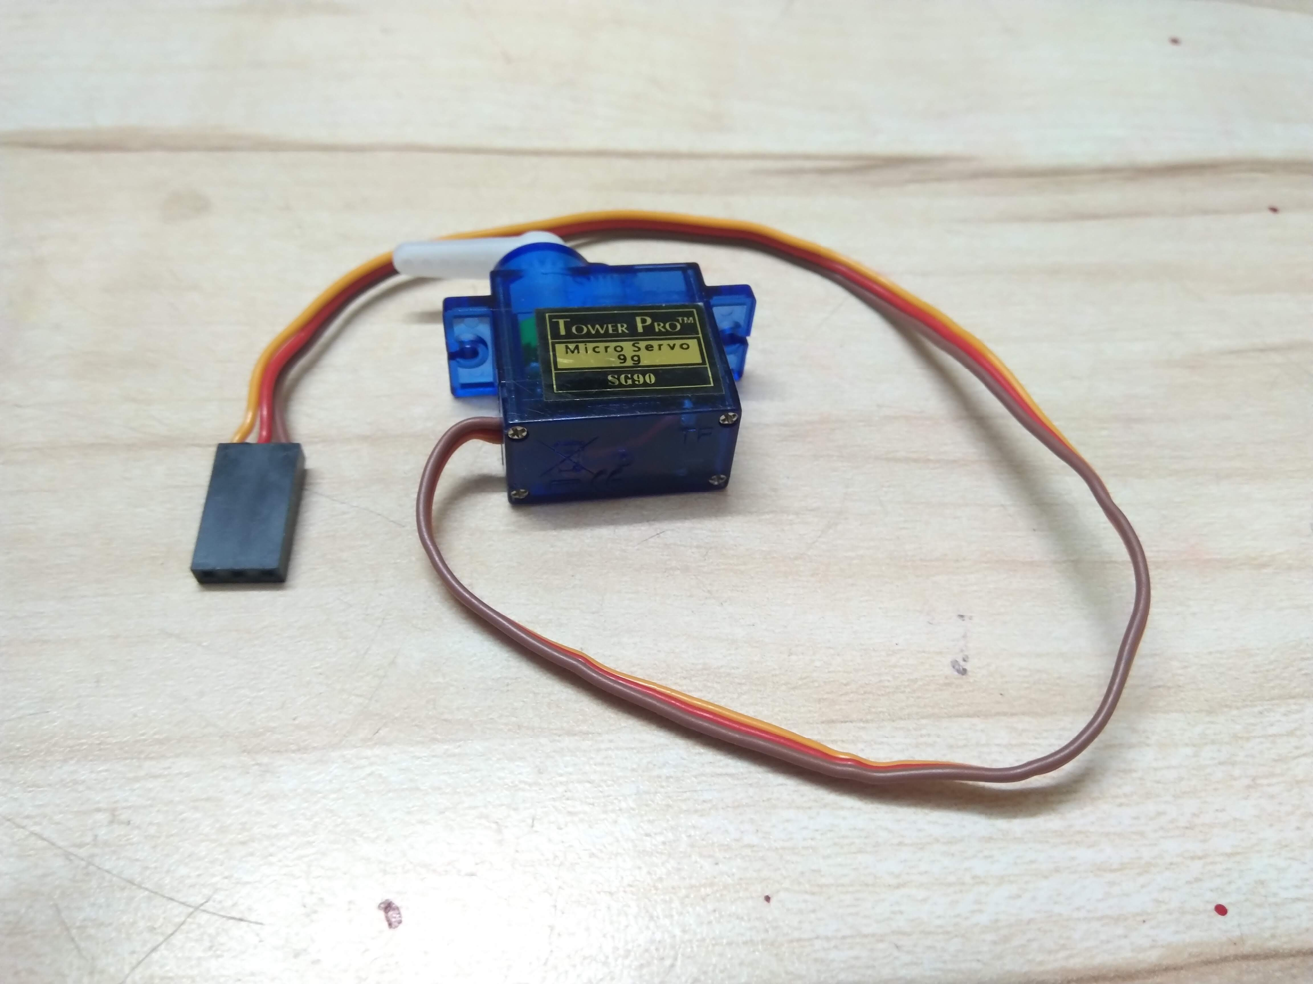
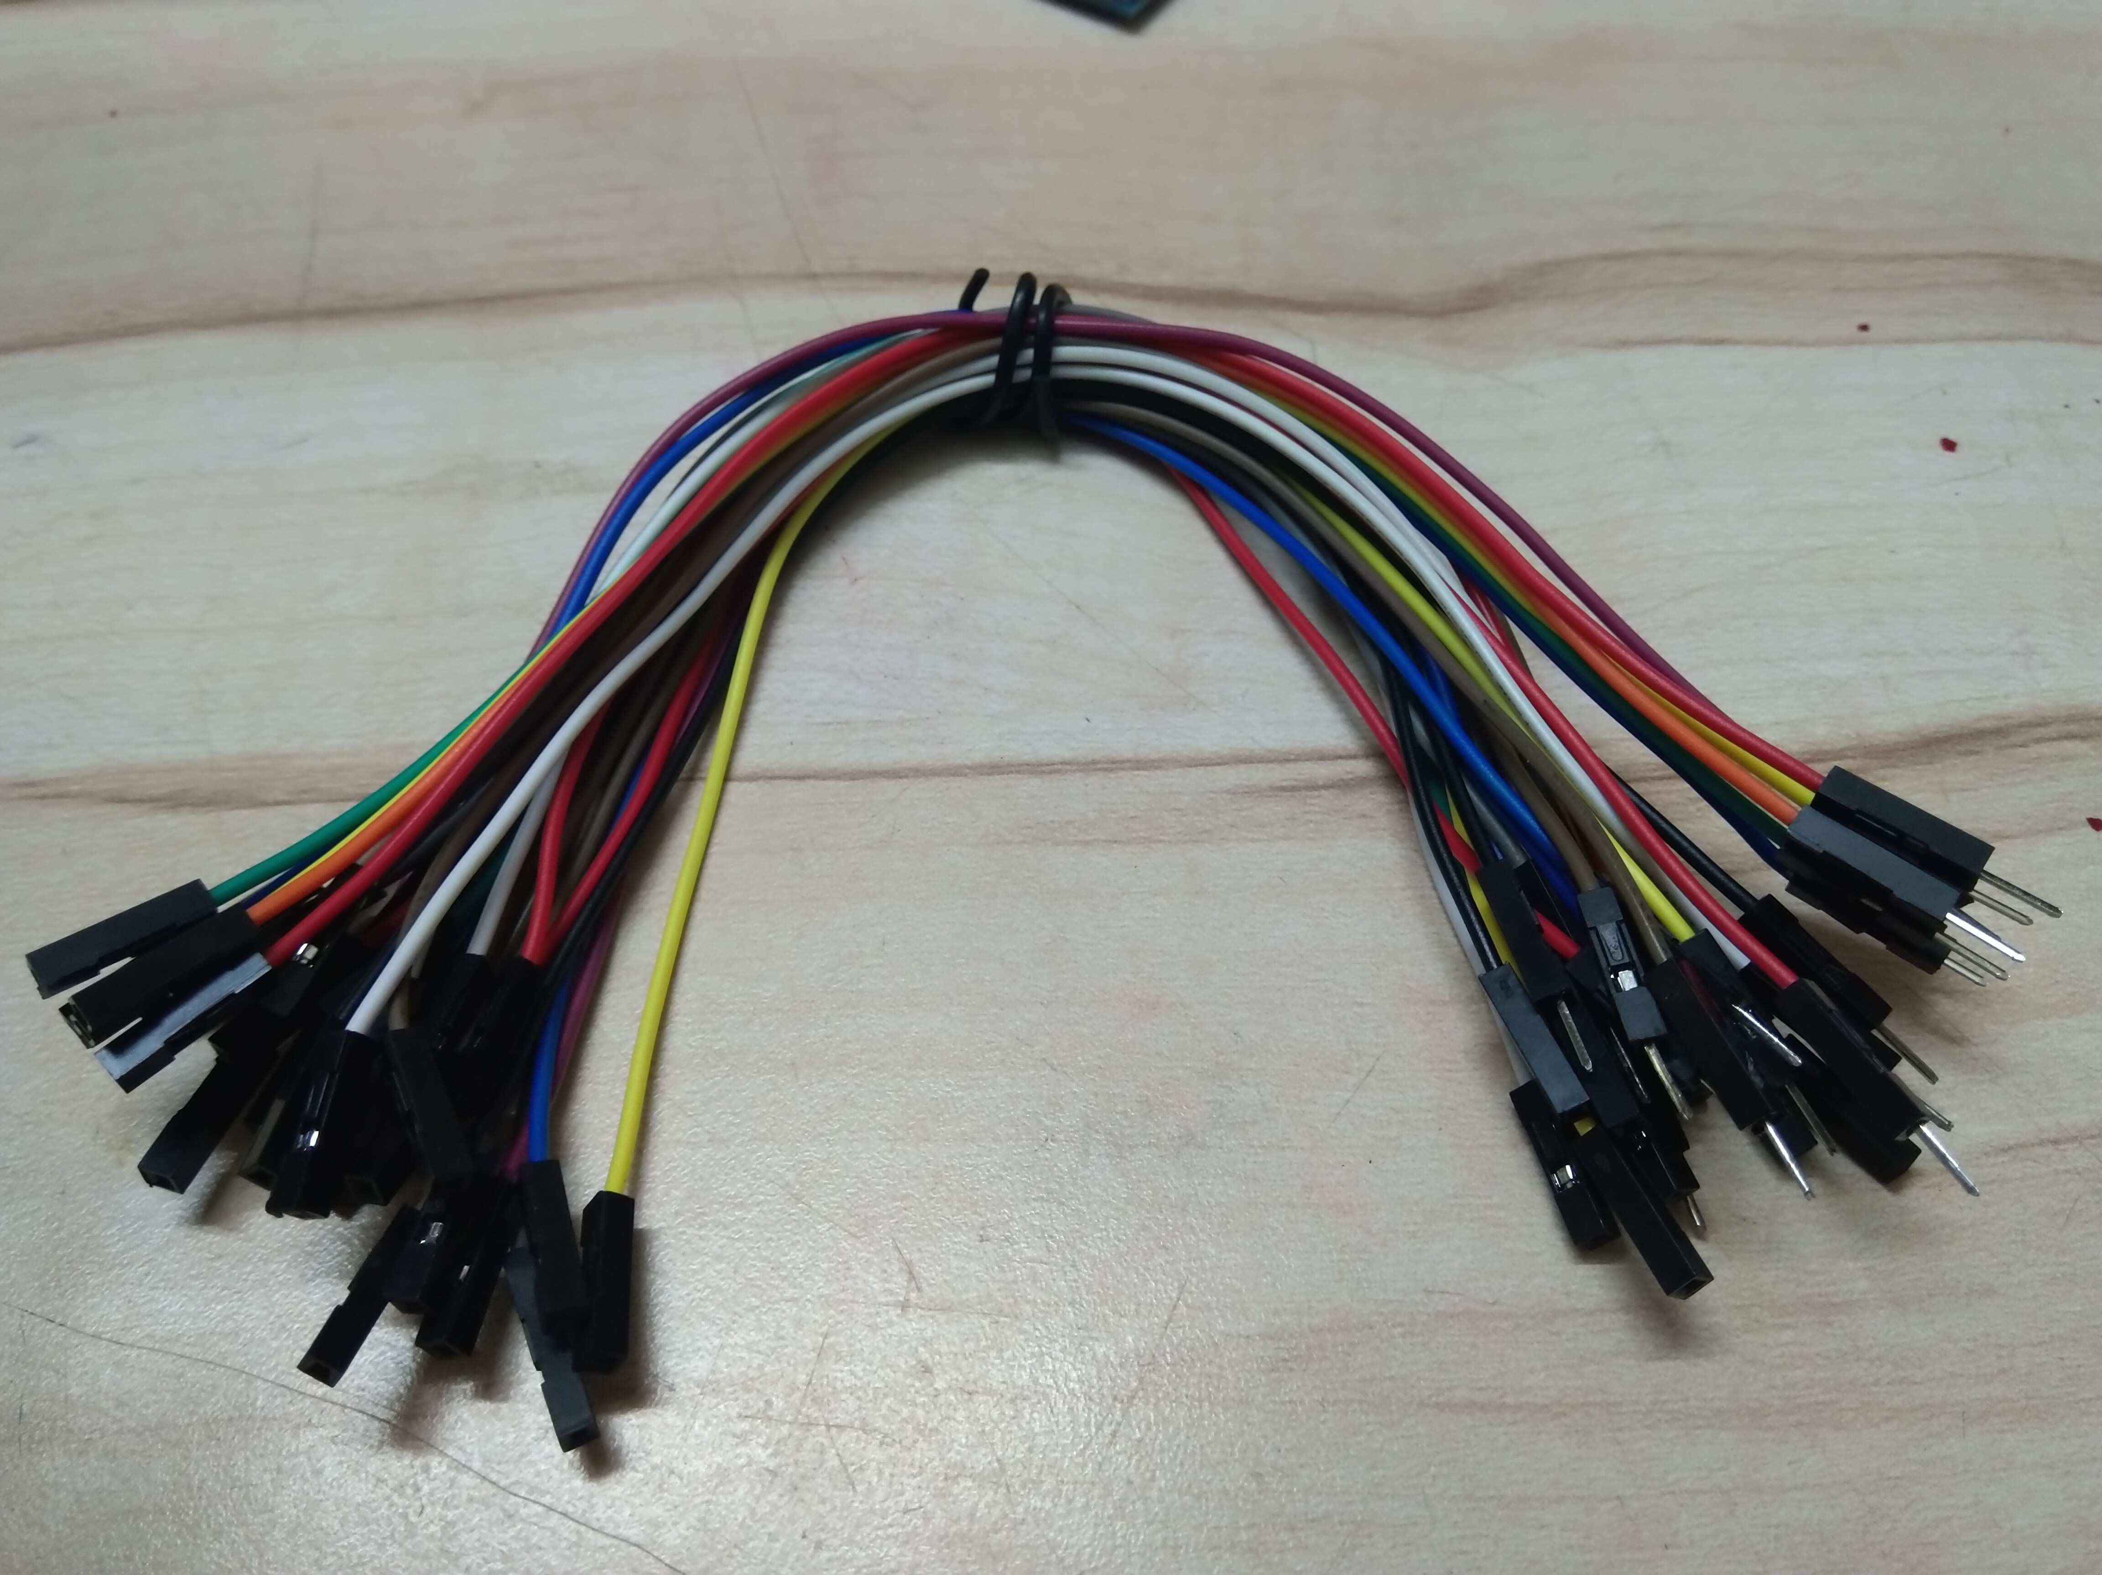
COMPONENTS

Slide 6
BLOCK DIAGRAM
database
Access system:
Servo motor
LEDs
ESP32
Power
supply
Personalized Switch:
Servo motor
LEDs
Universal ID:
online database
RFID Card
RFID Sensor
/Reader

Slide 7
STAGE 1:Access system
In the ACCESS SYSTEM the RFID sensor is interfaced with ESP32 using
SPI communication protocol. Here servo motor and LED is connected with ESP32 and is triggered with RFID card.
Selected RFID Card address is stored in the ESP32 which gets triggered when that particular card id showed to the RFID sensor
The RFID sensor scans the address and compares with the stored address.
When matched the LED turns green showing access GRANTED and then the servo motor works indicating opening of the doors.
Thus this system gives access to the person with Authorised RFID.

Slide 8
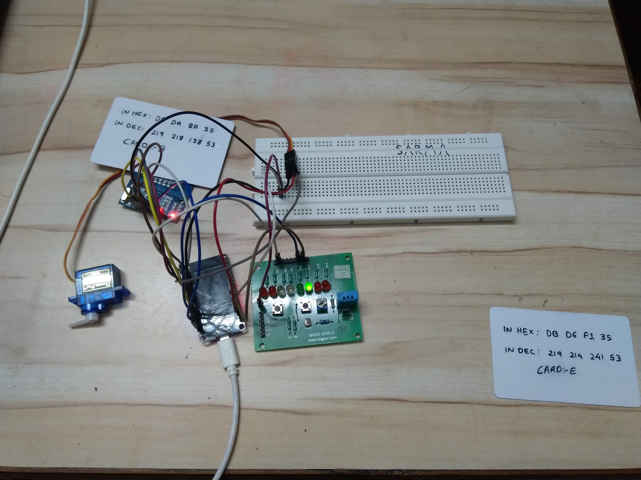
RFID Access GRANTED

Slide 9
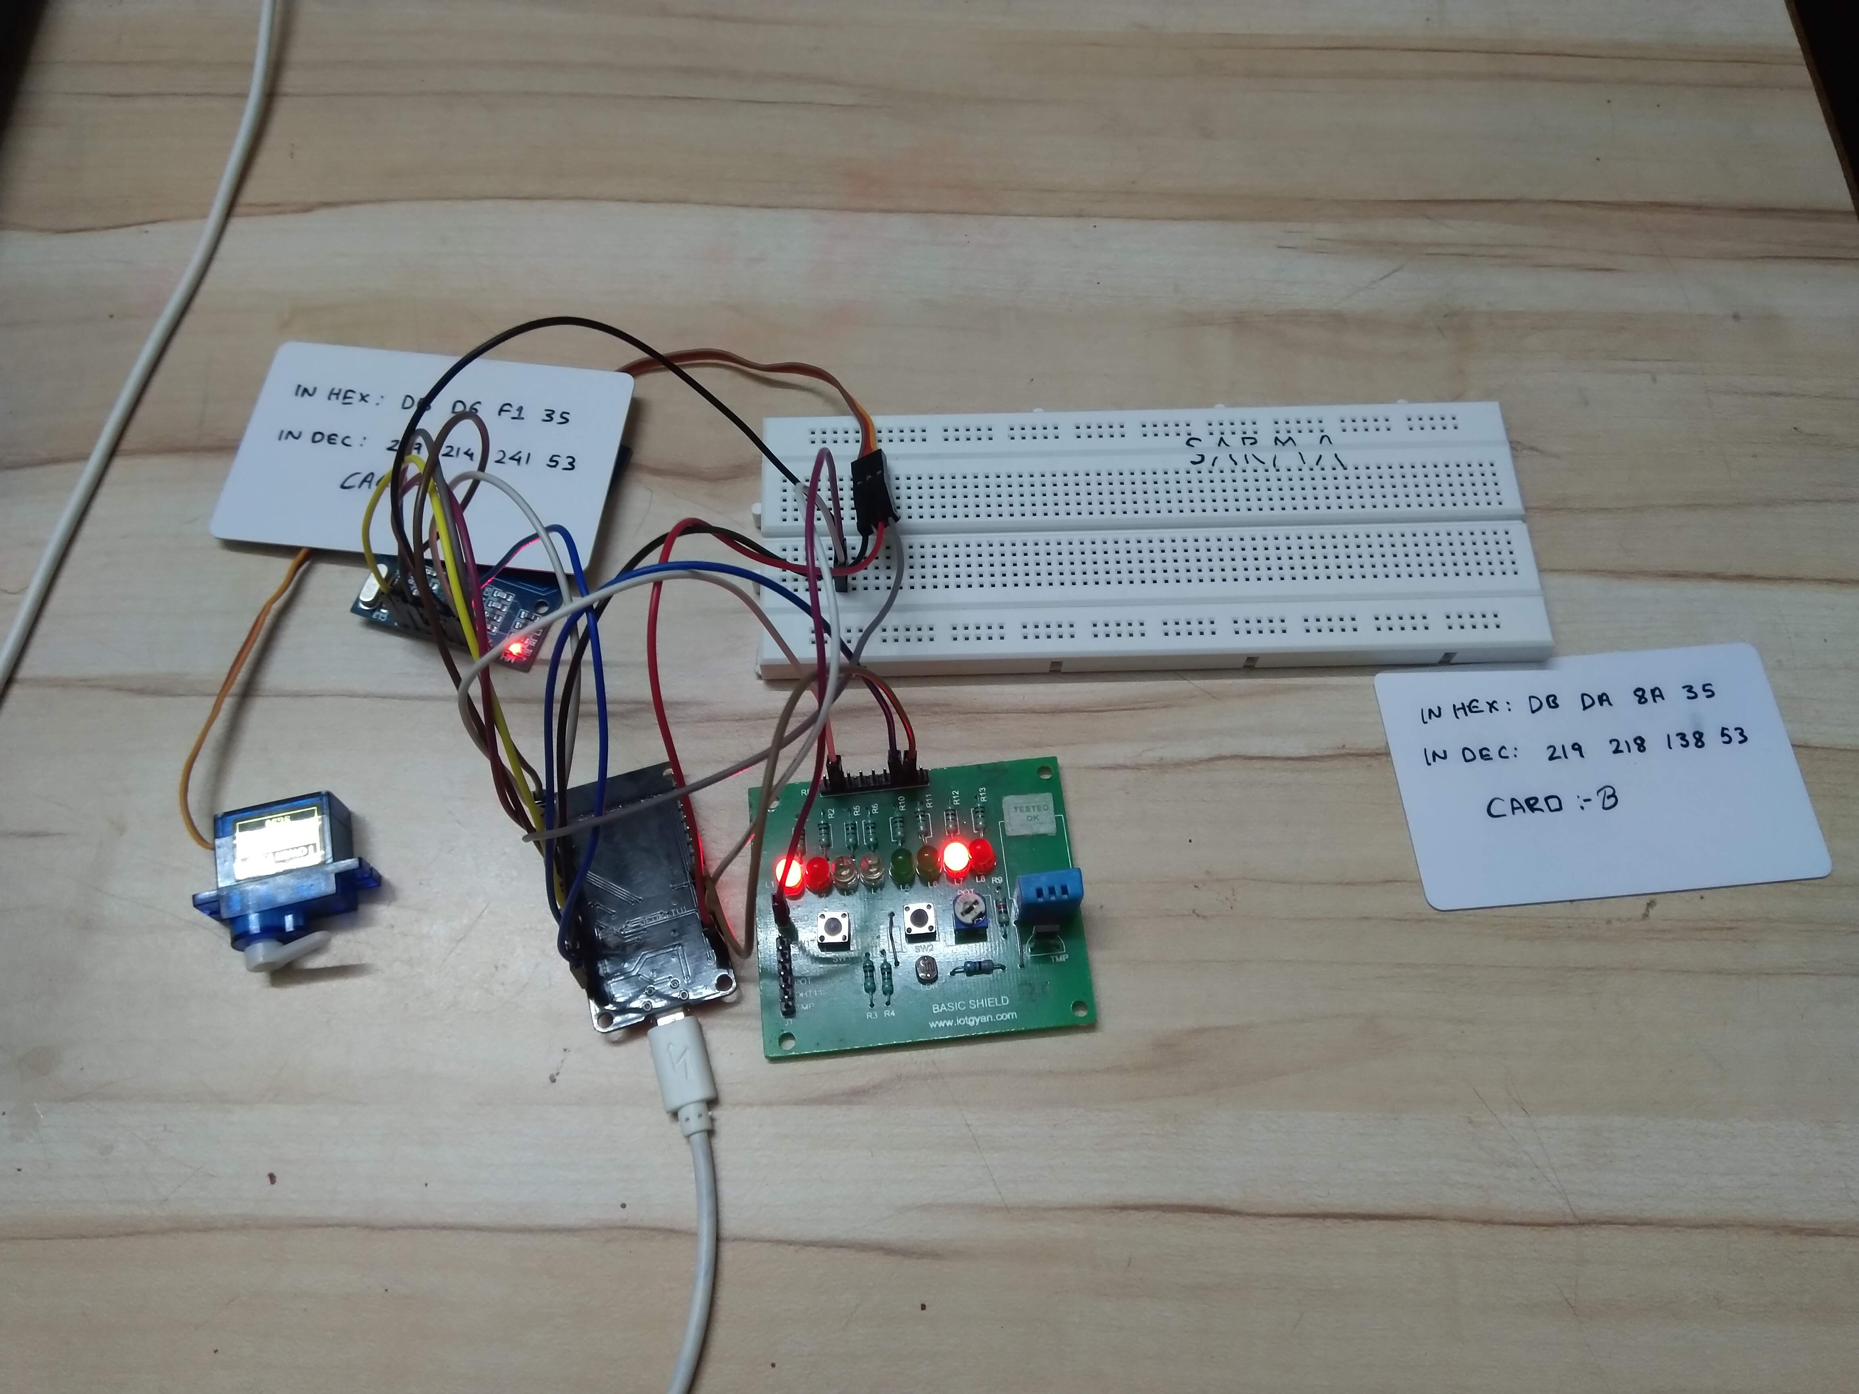
RFID Access DENIED

Slide 10
STAGE 2: Personal Switch
Similar to access system this module scanns for the Authorized RFID
But when GEANTED the work done can only be controlled with the same RFID
Another Authorized RFID cannot control the work until the GRANTED one stops the work.

Slide 11
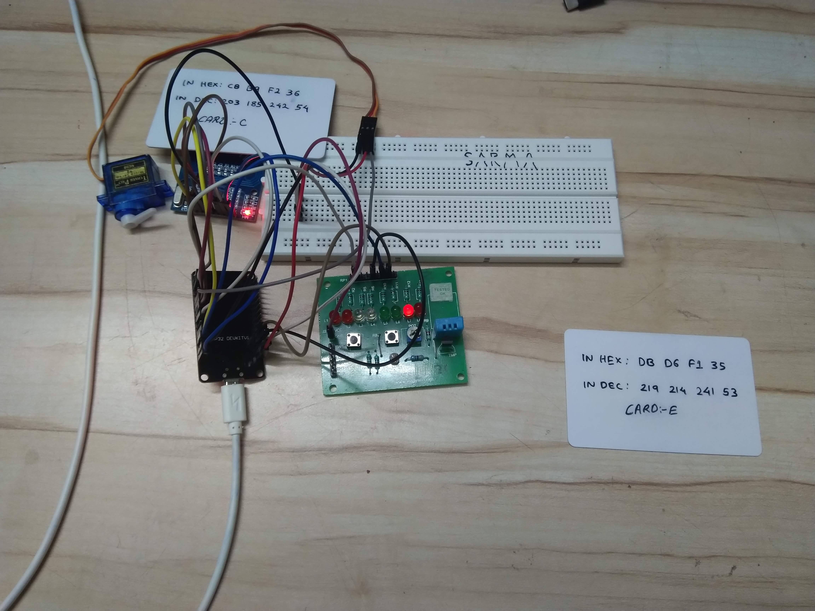
RFID GTANTED card starts LED

Slide 12
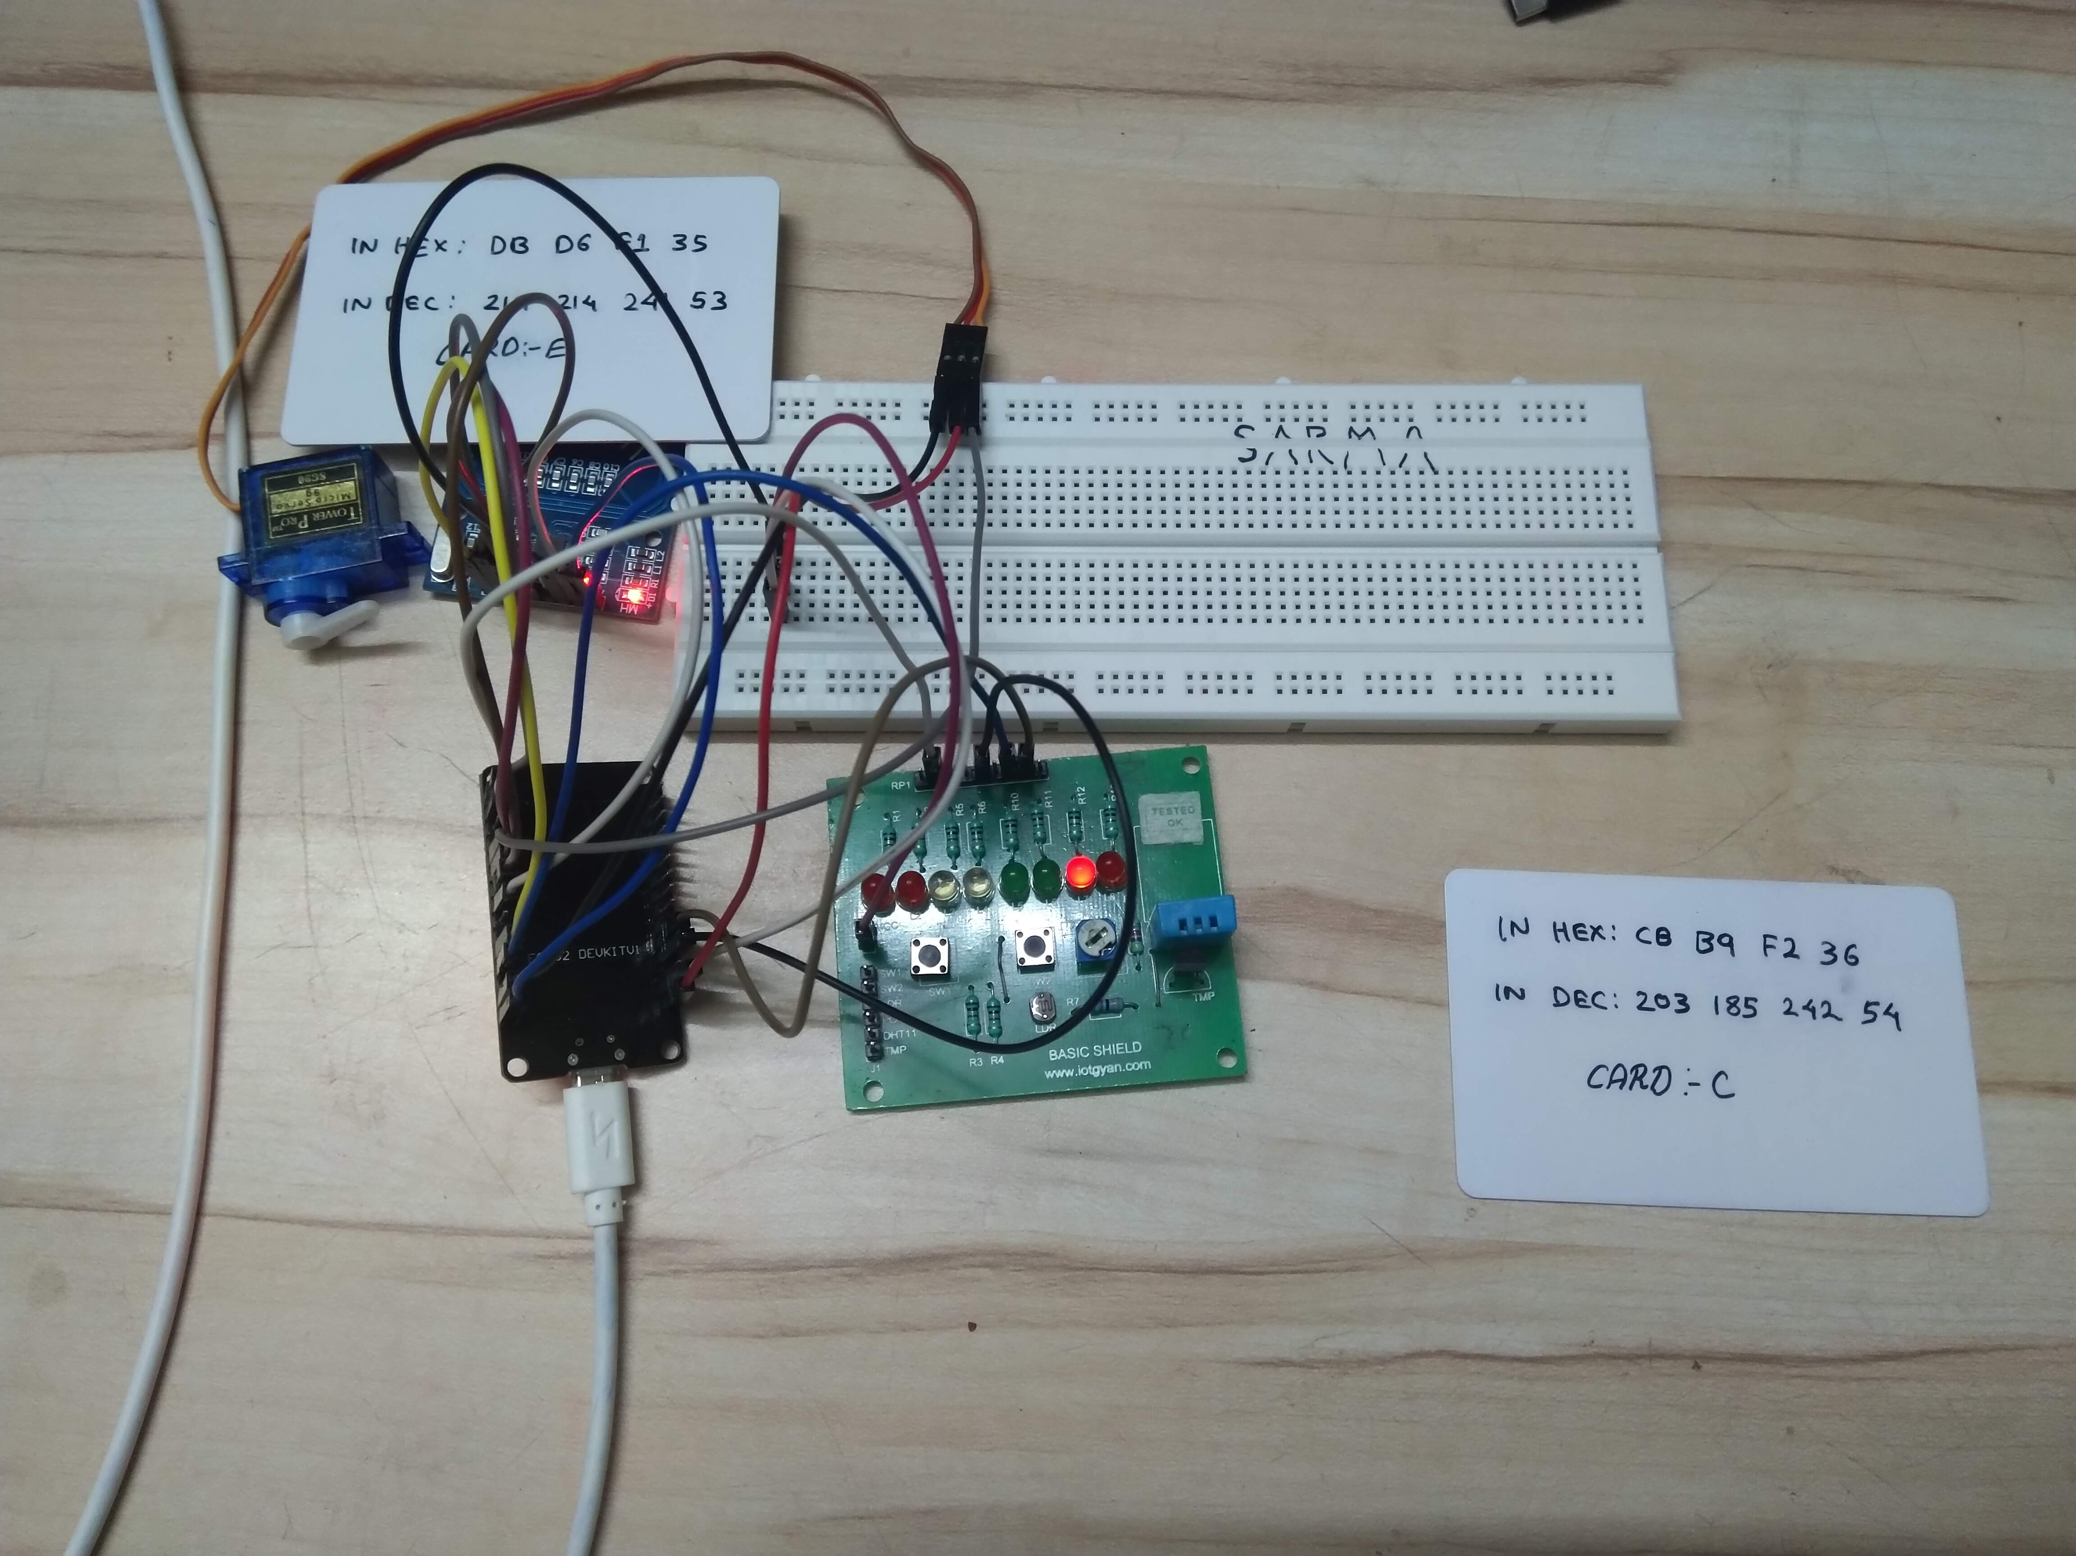
RFID 2nd CARD cannot hinder the process

Slide 13
STAGE 3: RFID UNIVERSAL IDs
This module scans the RFID and shows the data synced to it.
The RFID scans the card and via ESP32 we can access the details online in a webpage
The details can be as College ID, Aadhar card, Driving license etc.

Slide 14
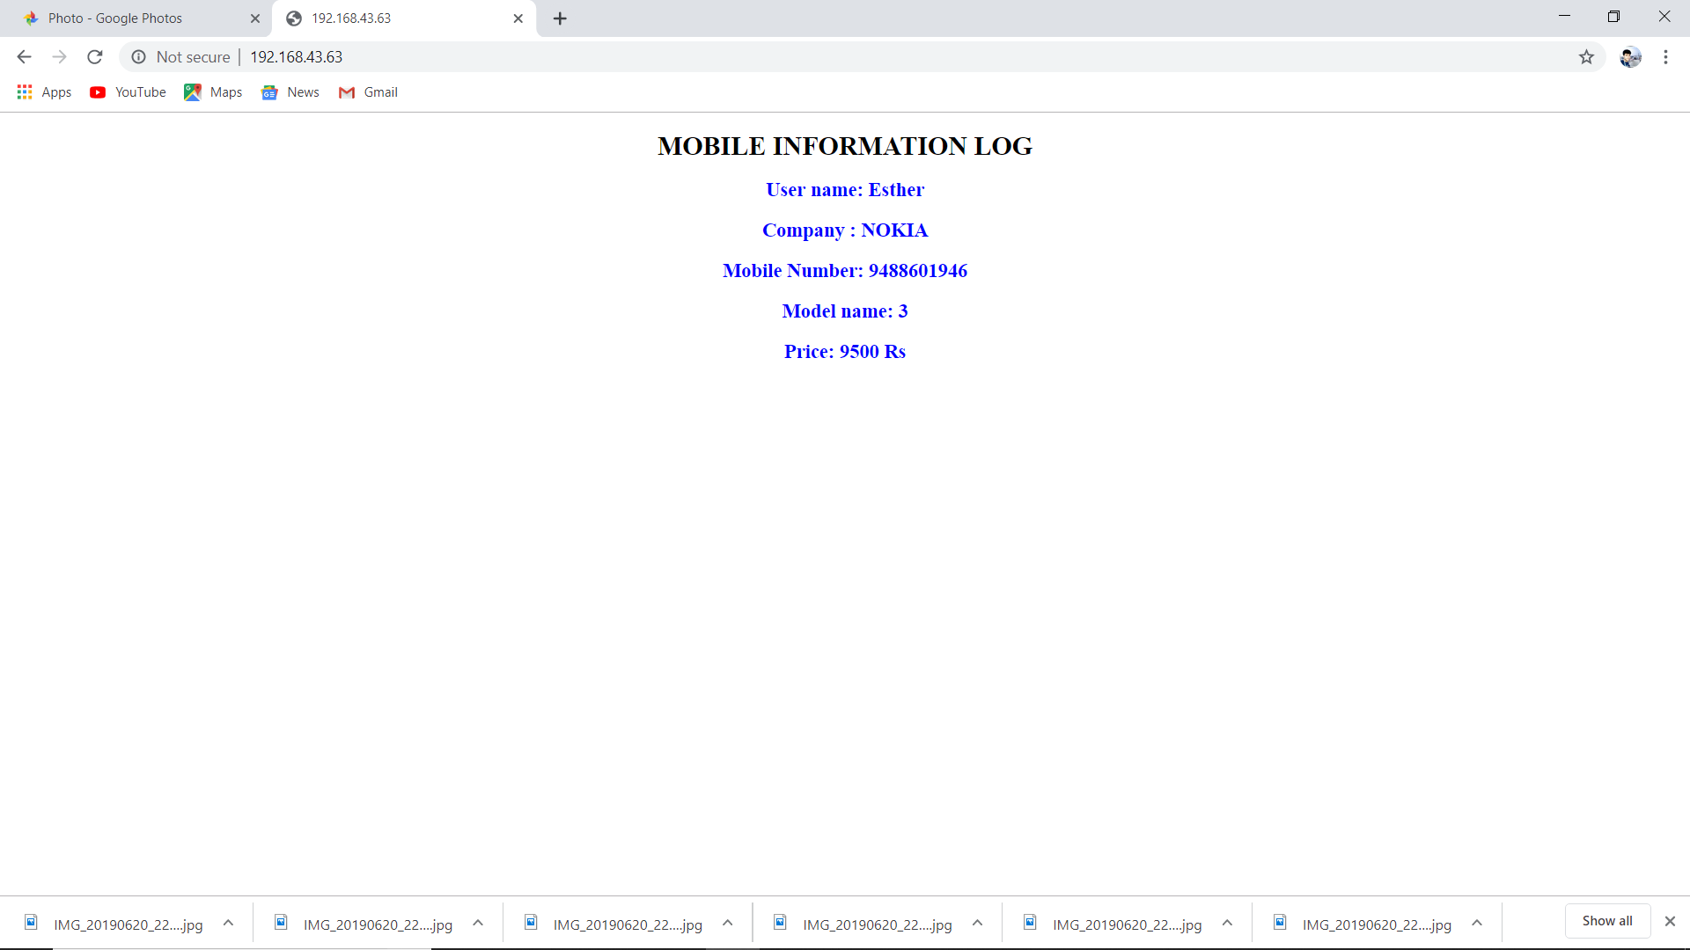
UNIVERSAL IDs

Slide 15
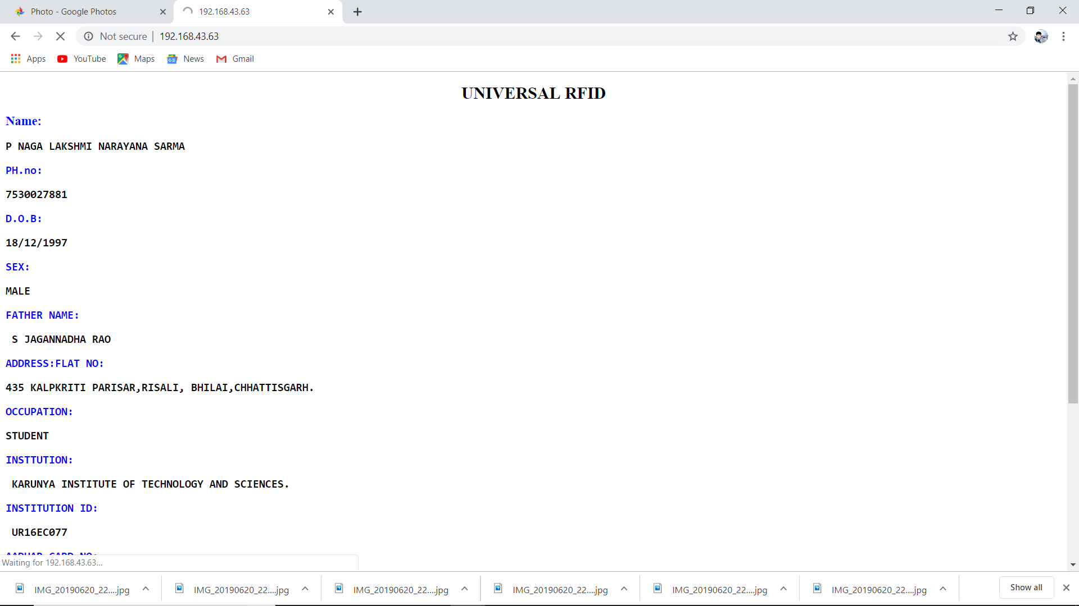
UNIVERSAL IDs

Slide 16
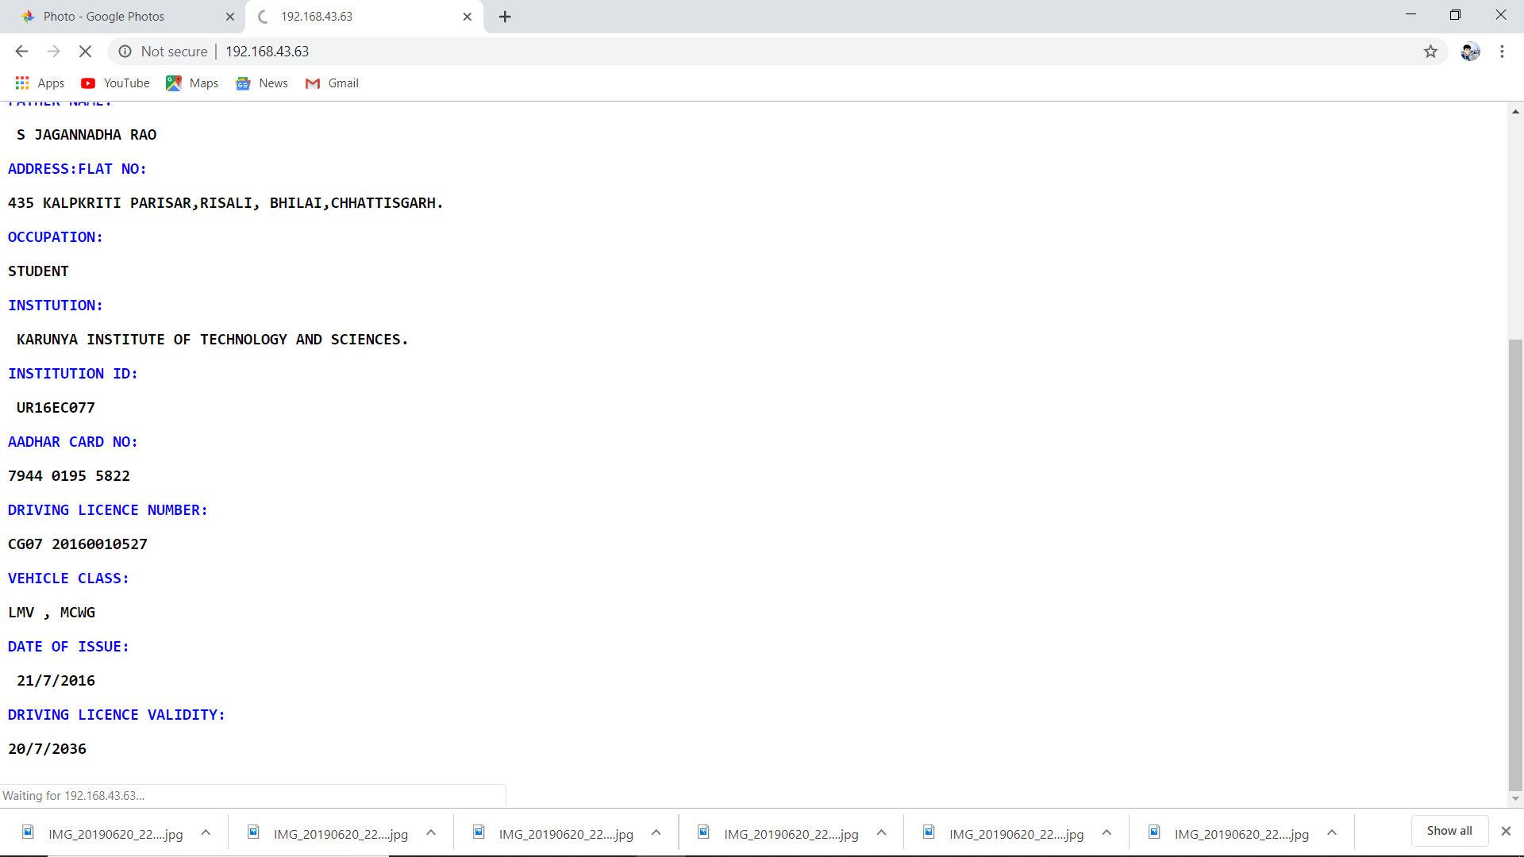
UNIVERSAL IDs

Slide 17
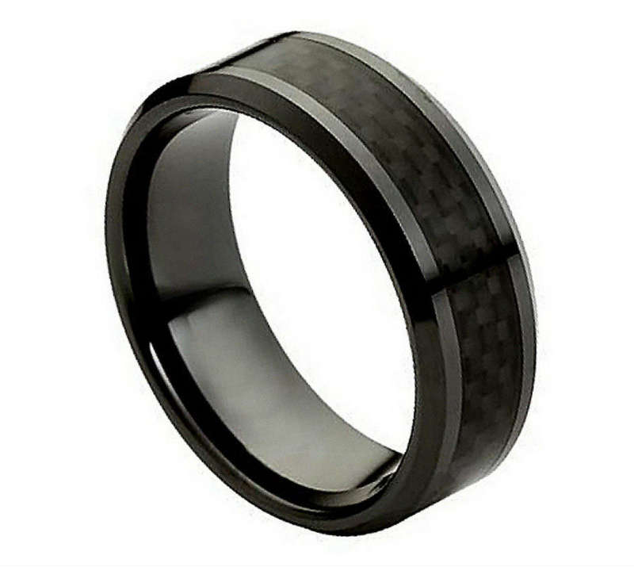
ADVANCAMENTS
RFID card replaced with RFID RINGS
Reduces storage
Hassle free
Convenient usage

Slide 18
THANK YOU

